Slide 1

Summer Schedule
Public Meeting
July 20, 2016
Ellis Ranch; Loveland, CO
Johnny Olson, Region 4 Transportation Director
James Usher, US 34 Project Director
us34canyon.codot.gov 970-667-1005 infous34@Kiewit.com
Notes:
CDOT Team – Johnny and James

Slide 2

Purpose of this meeting
Construction will begin soon
We said we would be back
Share decisions on traffic plan
Keep communication lines open
us34canyon.codot.gov 970-667-1005 infous34@Kiewit.com
Notes:
CDOT Presents – James or Johnny
We said we’d be
CDOT is committed to project.
Hour window for blasting, not two hour window.

Slide 3
Project Purpose - Permanent Repairs
Improve
Safety
Protect Assets
Reduce
Risk
us34canyon.codot.gov 970-667-1005 infous34@Kiewit.com
Notes:
CDOT Team – Johnny and James

Slide 4
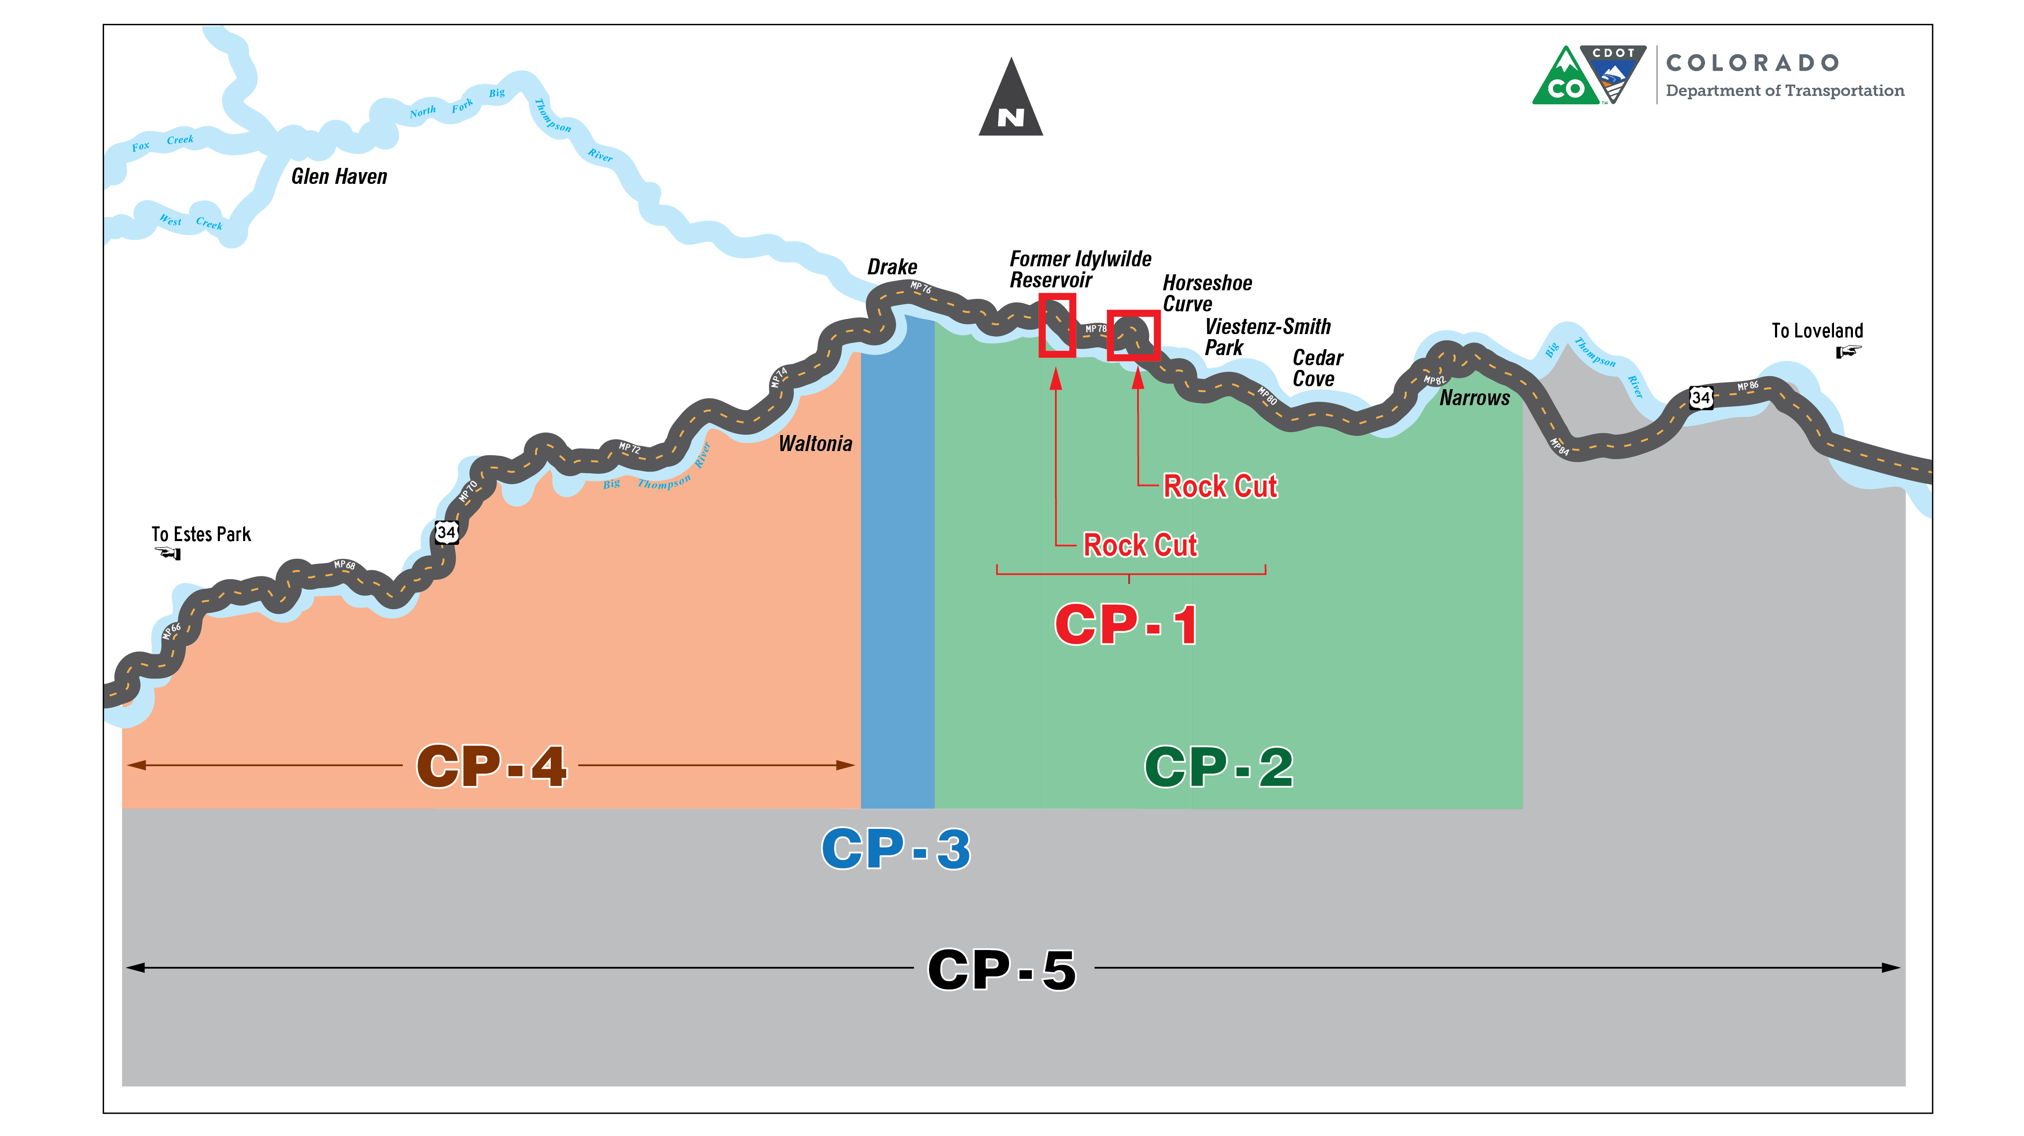
us34canyon.codot.gov 970-667-1005 infous34@Kiewit.com
Notes:
James or Johnny
Big picture for the corridor permanent repairs
Multi-year, multi-phase
CDOT will be discussing each phase with the community at public meetings throughout the project.
Construction will occur in phases - Start with Drake to Loveland
Summer 2016 intentionally “Low impact” - minimize traffic delays during peak summer season
Entire corridor (including all of the phases) rebuild - 3 years

Slide 5
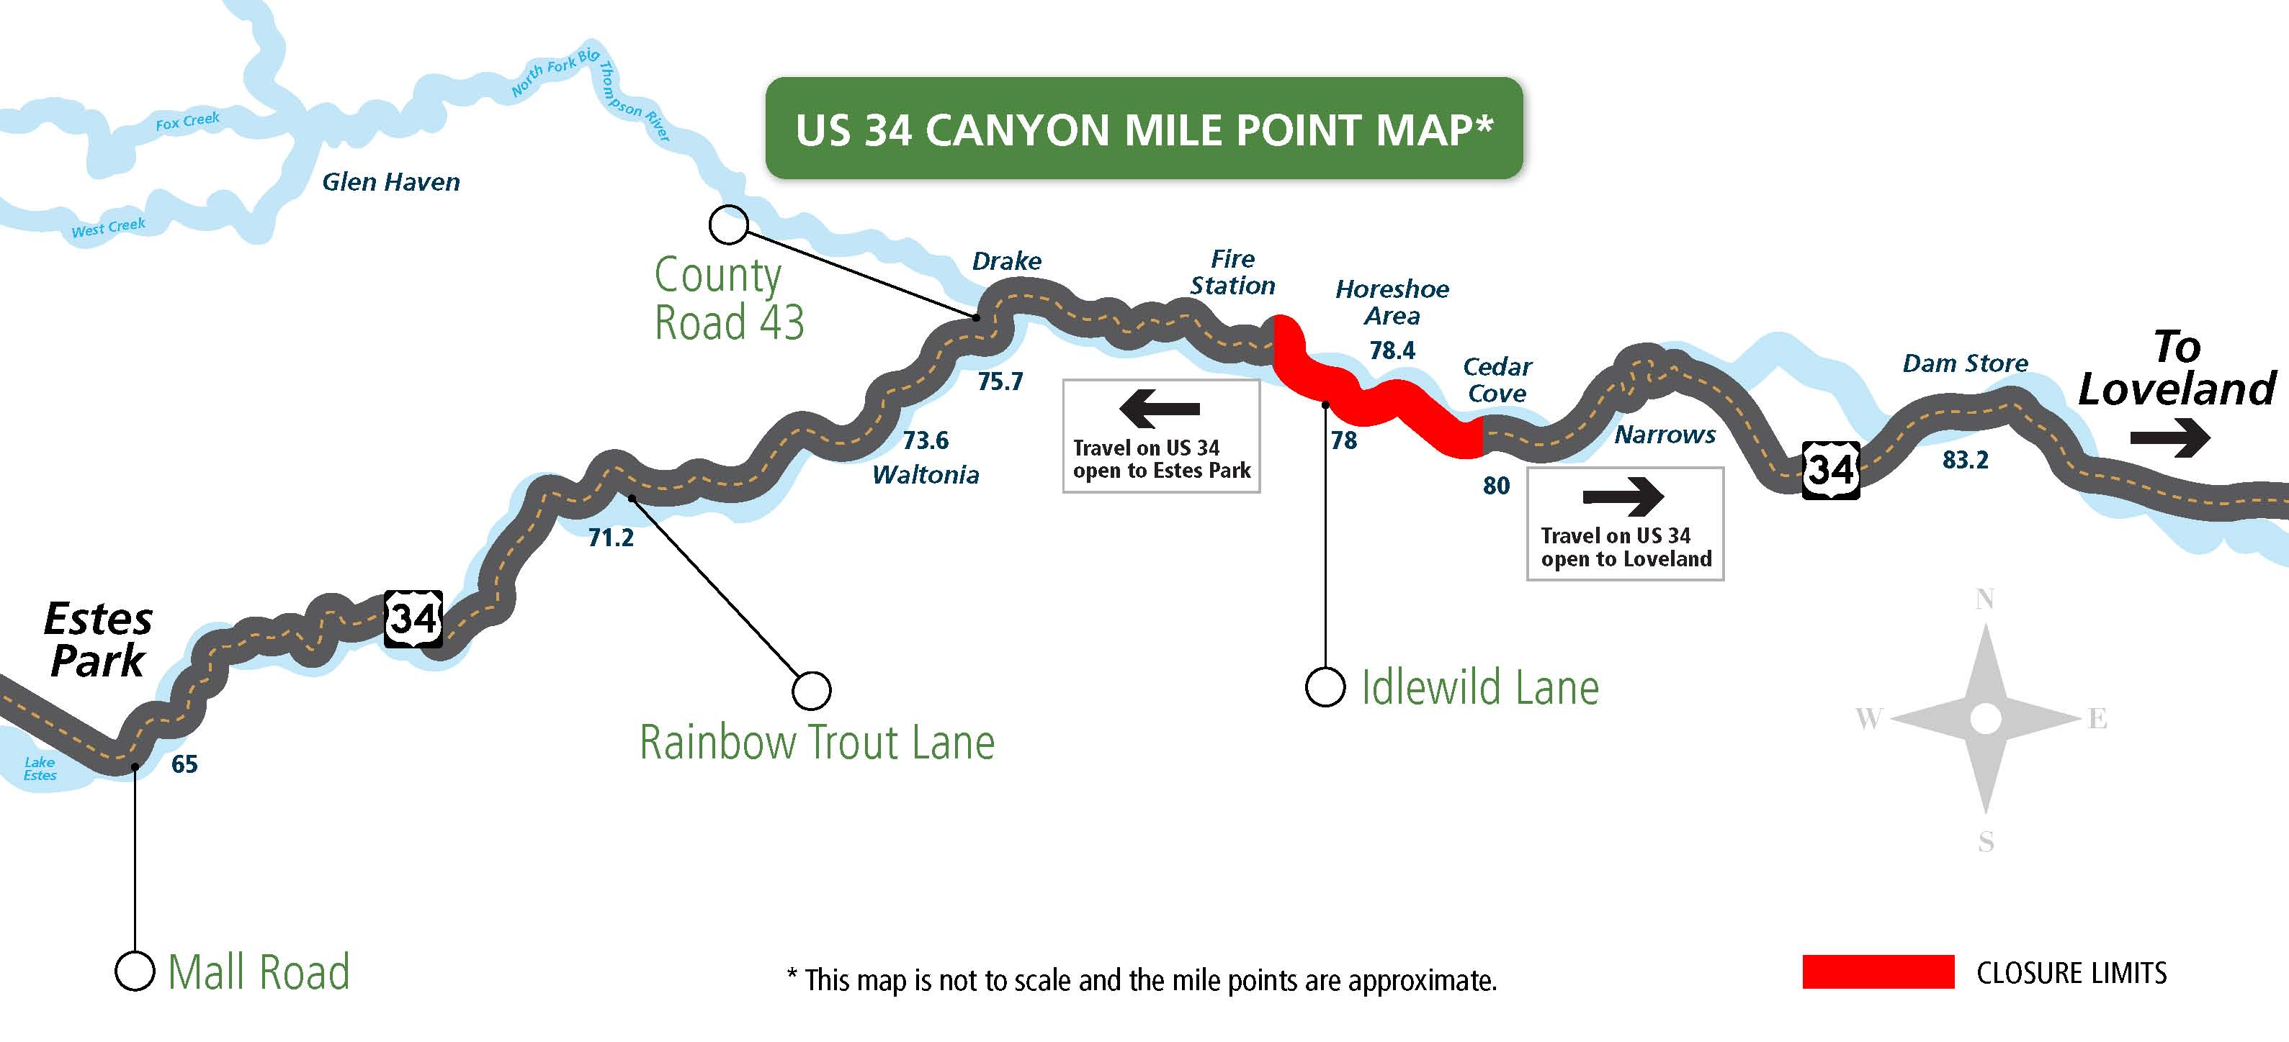
us34canyon.codot.gov 970-667-1005 infous34@Kiewit.com
Notes:
CDOT Presents – James and Johnny
Our focus today is on CP 1
Summer low impact schedule
October full closures between MP 77-80
CDOT will be working directly with Idylwilde residents (most impacted community) to support their access in and out of the construction area

Slide 6
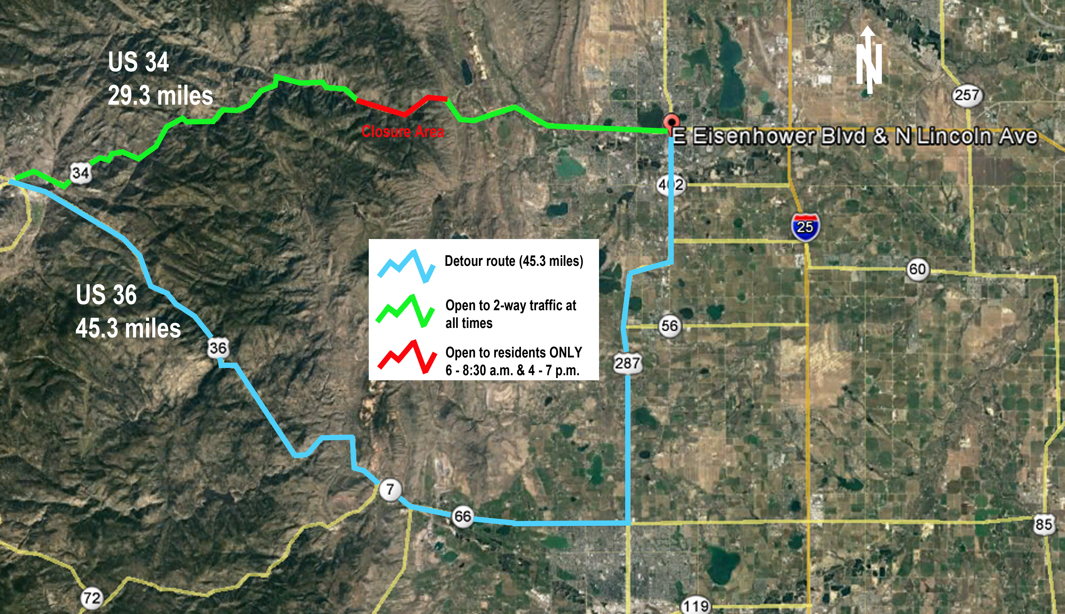
us34canyon.codot.gov 970-667-1005 infous34@Kiewit.com
Notes:
CDOT presents
Explain time difference between routes in presentation.
CDOT has driven both corridors at various times of day to estimate time differences.
MAYBE discuss Channel 7 story (if it has run by then)
When it comes to this closure, opportunities for through traffic are by pilot car only. There may be additional delays waiting for pilot car. Estes Park residents would likely experience the same time delays waiting for pilot cars as they would with the detour, ~ 20-25 minutes.

Slide 7
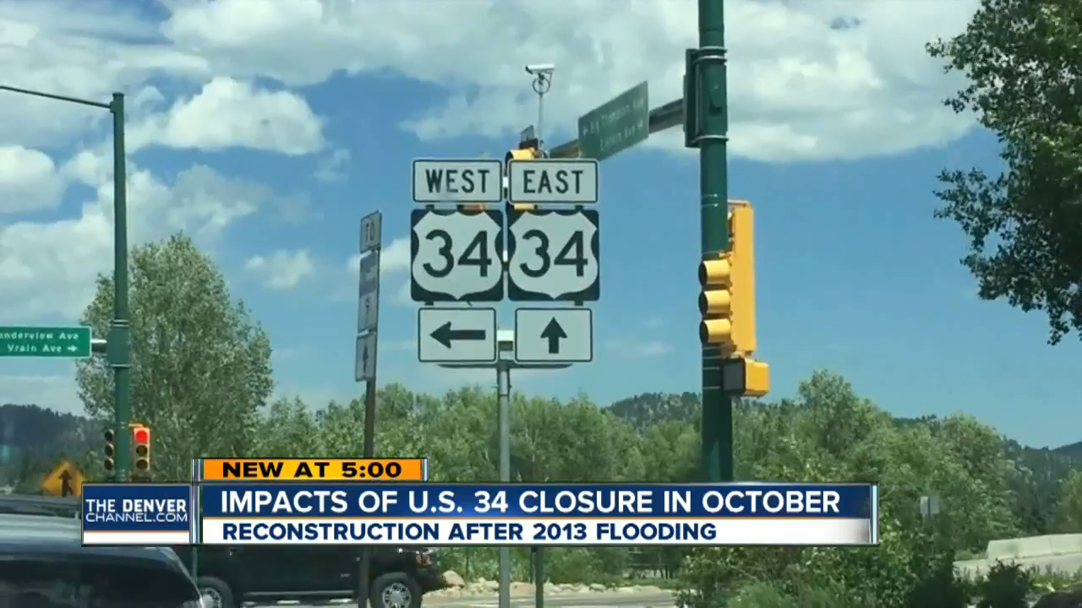
Notes:
CDOT presents
Explain time difference between routes in presentation.
CDOT has driven both corridors at various times of day to estimate time differences.
MAYBE discuss Channel 7 story (if it has run by then)
When it comes to this closure, opportunities for through traffic are by pilot car only. There may be additional delays waiting for pilot car. Estes Park residents would likely experience the same time delays waiting for pilot cars as they would with the detour, ~ 20-25 minutes.

Slide 8
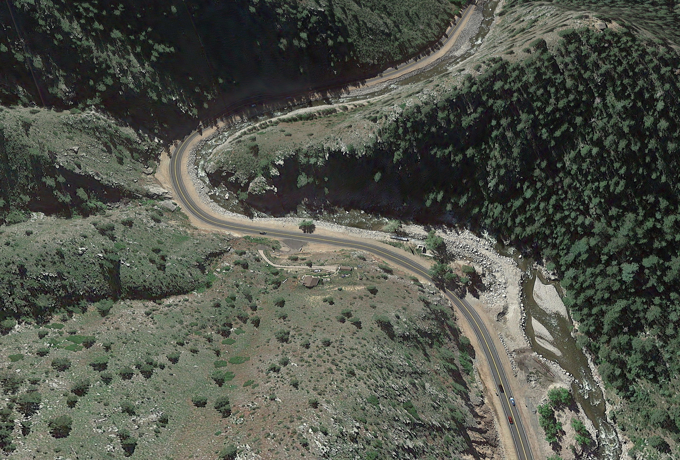
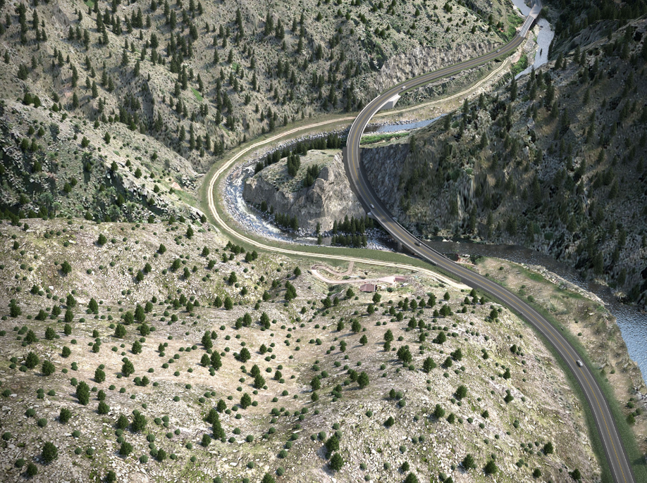
Construction Activities
July – August
  Office and yard set up near County Rd 29
  Barrier set up
August – October
  Rock blasting and rock removal
  Minimal traffic delays while blasting occurs (20 - 30 minutes)
  Traffic flagging
  Single lane closures for construction activities
    Traffic will be stopped at localized construction activities
Horseshoe Bend
us34canyon.codot.gov 970-667-1005 infous34@Kiewit.com
Notes:
Kiewit Presents
Construction starts at Horseshoe by Indian Village
Work off roadway
Minimal traffic delays while blasting occurs
(20-30 minutes)
Traffic flagging
Single lane closures for construction operations

Slide 9
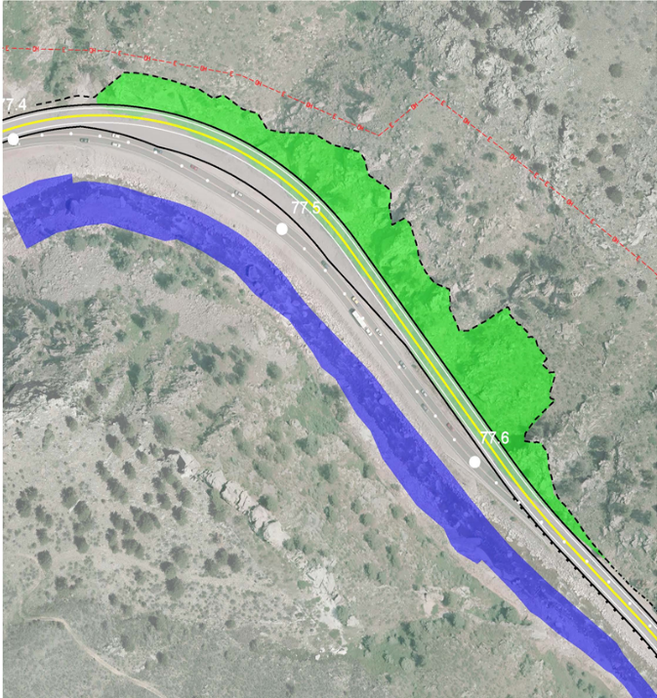
Construction Activities
October - June
  Blasting
  Road construction
  Bridge construction
  Start construction on other packages
  Open to through traffic from
  6 - 8:30 a.m. and 4 – 7 p.m. for
  permitted local residents only
  (to be discussed in detail in September)
  June – 2019
  Construction packages 2-5 (Estes to Loveland)
us34canyon.codot.gov 970-667-1005 infous34@Kiewit.com
Notes:
Idylwilde Cut
Kiewit – Include update that contractor is meeting and working with those residents.
Blasting
Rock removal
Road realignment

Slide 10

Business Support Opportunity
us34canyon.codot.gov 970-667-1005 infous34@Kiewit.com
Notes:
CDOT presents – James and Johnny
Representatives at meeting and available to talk with interested businesses

Slide 11
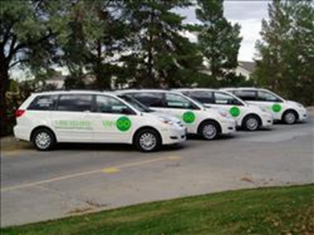


Commuter Support Opportunity
us34canyon.codot.gov 970-667-1005 infous34@Kiewit.com
Notes:
CDOT presents – James and Johnny
Representatives available to talk with commuters that might be interested in this service

Slide 12

Know Before You Go
Visit our website us34canyon.codot.gov
Lane restrictions and blasting times for next day
posted by 4 p.m.
Emails
Sign up for alerts of blasting activities by
visiting the website and clicking on this icon:
infous34@Kiewit.com for general questions
Information Hotline
(970) 667-1005
Voicemail for questions
us34canyon.codot.gov 970-667-1005 infous34@Kiewit.com
Notes:
CDOT Presents – James or Johnny
Hour window for blasting, not two hour window.

Slide 13

Upcoming Fall 2016 Meetings
CP1 meetings in September
Drake neighborhood meetings
Meeting with businesses west of Drake
us34canyon.codot.gov 970-667-1005 infous34@Kiewit.com
Notes:
CDOT Presents – James or Johnny
Hour window for blasting, not two hour window.

Slide 14
QUESTIONS?
us34canyon.codot.gov 970-667-1005 infous34@Kiewit.com
Notes:
CDOT Presents – James or Johnny
Hour window for blasting, not two hour window.

